Slide 1
GIS Basics for Beginners
Watson Harding
GIS Specialist
Kentucky 911 Services Board

Slide 2
Outline
Section 1: GIS Basics
a. What is GIS?
b. GIS and Next Generation 9-1-1
c. GIS Software Options
Section 2: Tips and Tricks
Section 3: Questions

Slide 3
What is GIS?
GIS stands for Geographic Information Systems
A computer system that analyzes and displays geographically referenced data
Ex. A Fire Hydrant layer contains both points representing the location of hydrants and the attributes of every individual hydrant such as flow capacity, last inspection
Commonly points, lines, and polygons
Geometry=Spatial properties, Attributes=Table data

Slide 4
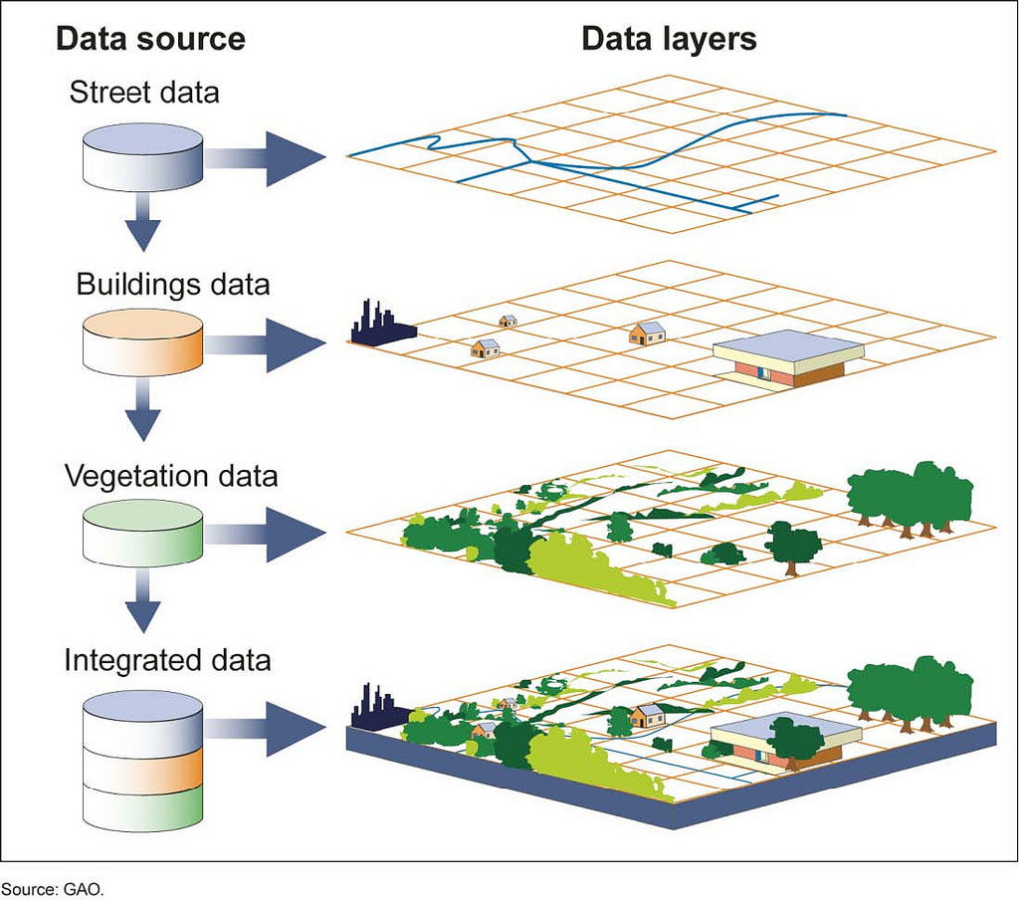

Slide 5
GIS is Foundational to Next Generation 9-1-1
At its most basic, the goal is to connect the caller with the correct PSAP as quickly as possible while minimizing complications (transfers, etc.)
This works through the relationship of the cellular device and PSAP Boundaries (Geospatial Routing)
The phone broadcasts its location, a point, and compares it to PSAP Boundaries, polygons. The call is routed to the PSAP polygon in which the caller’s point is located.

Slide 6
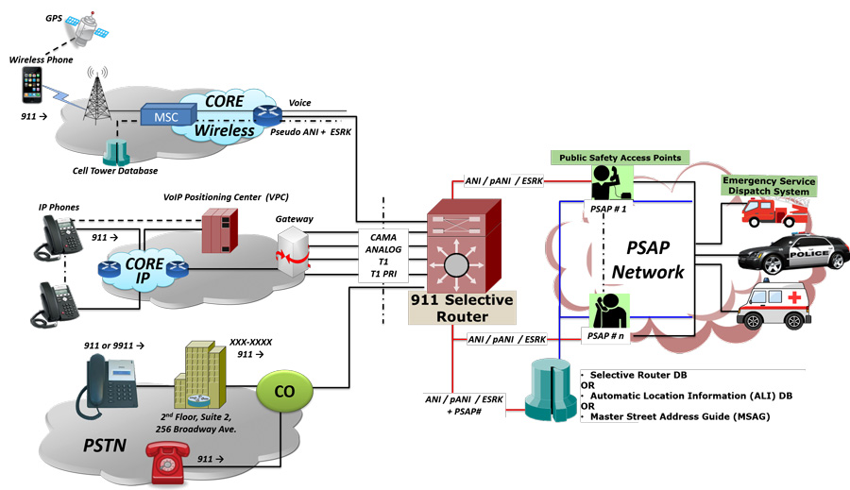
It’s a little more complicated than that…

Slide 7
GIS and NG911
NG911 is coming
KY911SB has been allocated funding and is in the RFP process
Need statewide layers, without gaps and overlaps
Created by aggregation of PSAPs’ GIS data submissions
KY911SB contracted with GeoComm to QC and aggregate submissions
Project Page
GeoComm KY Team Email
NENA GIS Data Model

Slide 8
Upload Process
PSAPs submit their package with all required layers by uploading to GeoComm’s browser-based GIS Data Hub
Can ingest zipped Shapefiles and Geodatabases, more later
Fields mapped to NENA GIS Data Model
The submission is ran through attribute and geometry checks
If submission is free of critical errors, it is aggregated into statewide layers. Otherwise a Fallout Report generated.

Slide 9
Requirements
Every PSAP must upload their GIS Data once per quarter
Notify Board and GeoComm of personnel changes
Help always available
Watson.Harding@ky.gov
GCTeamKY911@geo-comm.com

Slide 10
NG911 GIS Data Layers
Provisioning Boundary: the polygon layer that assigns responsibility for the data within that polygon
If you need to create, same geometry as PSAP Boundary with small number of attributes
PSAP Boundary: the polygon layer that the caller location is hitting against
Answers “where should the call go?”
Often initially based on existing boundaries like county
Real life is more complicated and should consider access etc.
Need agreement with neighboring PSAPs, contact us for contacts and guidance

Slide 11
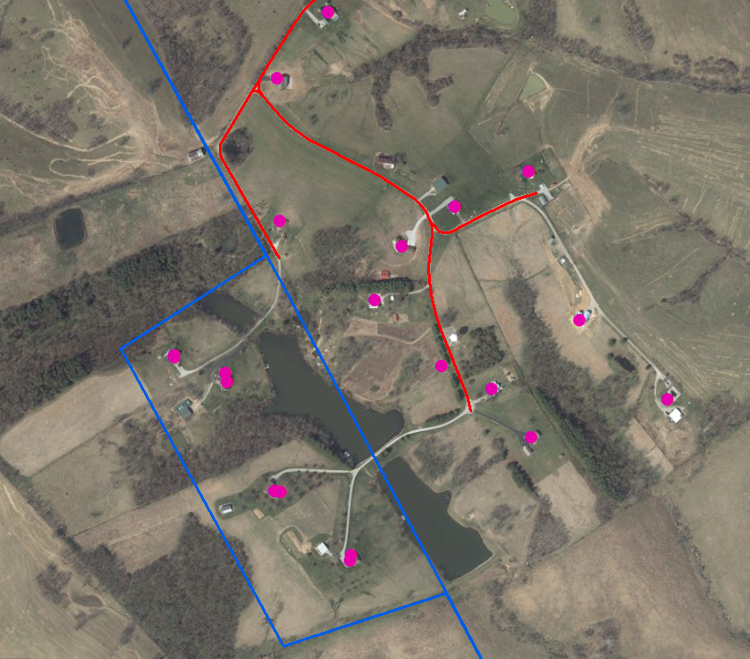
PSAP A
PSAP B
Overlap

Slide 12
The PSAP Boundary is All
All GIS Data should be within, or coincident with PSAP Boundary
The PSAP Boundary should never be ‘empty’

Slide 13
NG911 GIS Data Layers
Responder (Emergency) Services Boundaries: polygon layers for Law, Fire, and EMS
Attaches responder information to the incoming call
Road Centerlines: polyline layer used, if needed, to locate caller based on road address ranges
Site and Structure Address Points: point layer of, at minimum, addressed structures
Attaches nearest address, within tolerance, to the incoming call
Simple explainer

Slide 14
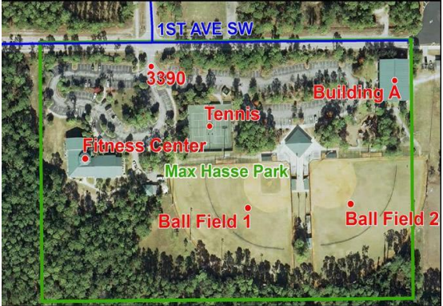
Should I collect it?
The minimum is addressed structures
Don’t forget notable subunits
Apartments
Multiple structure points
Can share same address number
Differentiated by fields like Building
Collect what can be maintained
And what is most useful

Slide 15
SSAP Challenges
There aren’t limits to potential granularity
Current data is better than obsolete data
Elevation (Z-axis) harder to accurately capture than x,y
Improvements needed from carriers
Affects tall multistory buildings
Need the PSAP community to share their experiences and best practices

Slide 16
Kentucky’s Current Progress

Slide 17
Are we done yet?
GIS Data needs to be maintained and kept current
GIS Data Hub has limits
Great for attribute checks
Geometry checks will indicate some issues
It won’t tell you if a road centerline isn’t properly aligned or house demolished
Almost every PSAP has contributed their ‘piece’ of the puzzle
Now we must put it together and keep it current

Slide 18
Internal or External Workforce
Who can you hire to maintain your data?
Datamark, GeoComm, CDP-MapSync, and others
Area Development Districts
Maintaining your data internally
Costs: software, salary, and time
Collaborate with other parts of local government

Slide 19
GIS Software Options
ArcGIS: umbrella term for software published by ESRI, the main originator and developer of GIS software
QGIS: a free and open-source GIS software product like other open-source products (OpenOffice, Firefox, Linux, etc.)
Third Party Editors: software products commonly built on ESRI software with simplified functionality
Ex. GeoConex GIS Map

Slide 20
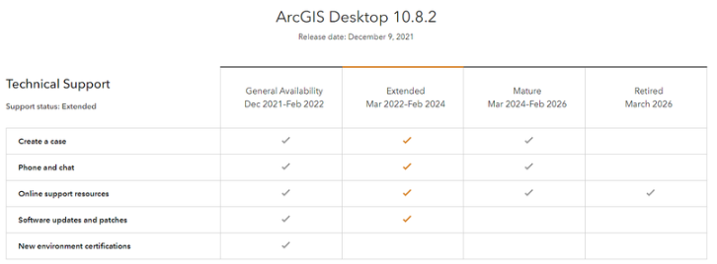
ArcGIS 10.x
Last version 10.8.2
Support set to end
Have a plan to transition

Slide 21
ArcGIS Pro 3.3
ESRI business trends are towards greater integration with ArcGIS Online (AGOL), subscription model, web-based analysis
Be aware of license levels
Creator (Basic) lacks functionality needed
Professional (Standard) sufficient, $2,200/yr
Most add-ons, extensions, and extra credits are unnecessary
Licensing managed in AGOL account

Slide 22
QGIS
Open-Source (Free)
Comparable functionality to ArcGIS
Smaller userbase, different learning curve

Slide 23
Third Party Mapping Software
Provide a simplified map viewer and editor
Can lack functionality for user to make necessary edits
Can complicate workflows

Slide 24
Training
Free resources out there, may require digging
ESRI and QGIS have free tutorials
My advice: get your toes wet

Slide 25
Tips and Tricks
Shapefiles vs. Geodatabases
Demos
Understanding where your data “lives”
Selections
Field Calculations

Slide 26
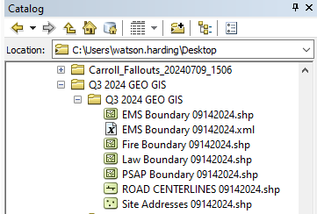
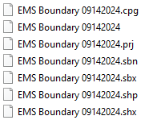
Shapefiles vs. Geodatabases
Two most common file storage methods
Shapefiles
Still commonly used
Be aware of subfiles
Become unstable when large

Slide 27
Shapefiles vs. Geodatabases
Geodatabases
Technically ESRI proprietary format, conversion to and from in QGIS
Greater functionality
Domains
Topology
Can export to shapefile if needed

Slide 28
Uploading
With shapefiles, verify that all layers and constituent files in the same folder
Send to Zip
With geodatabase, verify all needed layers within
Send to Zip

Slide 29
Questions?
Watson.Harding@ky.gov

